Slide 1
Health care problem
-Vivek Dodia

Slide 2
The task is to analyze the clinical and financial data of patients hospitalized
I have solved this problem using python as a programming language.
Libraries used in this project are NumPy, Pandas and Matplotlib.
Step1: Read all the csv file .
Step2: Perform Exploratory Data Analysis
Step3: Data Cleaning
Step4: Data Visualisation using Matplotlib.

Slide 3
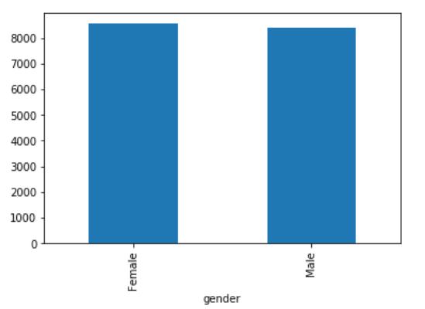
Graph 1: Gender V/S Patient Id

Slide 4
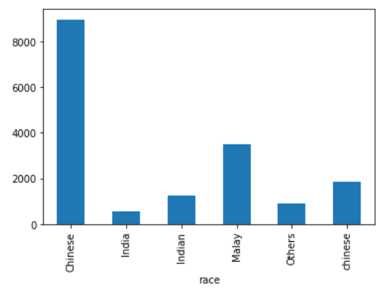
Graph 2: Race V/S Patient Id

Slide 5
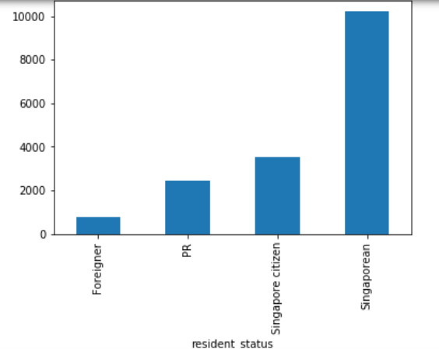
Graph 3: Resident Status V/S Patient Id

Slide 6
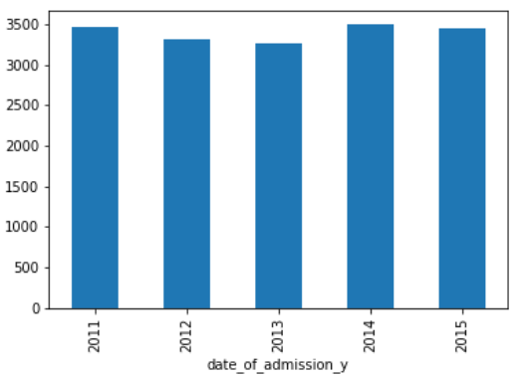
Graph 4: Admission Year V/S Patient Id

Slide 7
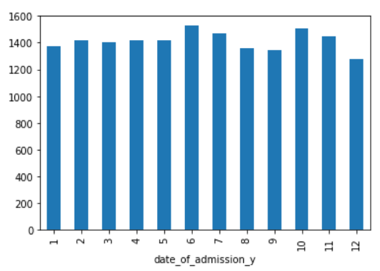
Graph 5: Admission Monthwise V/S Patient Id

Slide 8
Graph 6: Total Number of Days Hospitalised V/S Patient Id

Slide 9
Thank You

